Slide 1

Eco-friendly floating bottle
Web3+AI social network designed for users and the environment
speaker: MaxWell Pan

Slide 2
Agenda
02
04
01
03
05
Environmental
perspective
Environmental
protection fund
Environmental
issues
International policy on the environment
Eco-friendly
floating bottle
The role of environmental protection funds in environmental protection
Future state vision
Introduction to environmental issues
Social and promotion of environmental protection concepts
The platform and community of world environmental protection

Slide 3
01.Environmental issues
Introduction to environmental issues

Slide 4
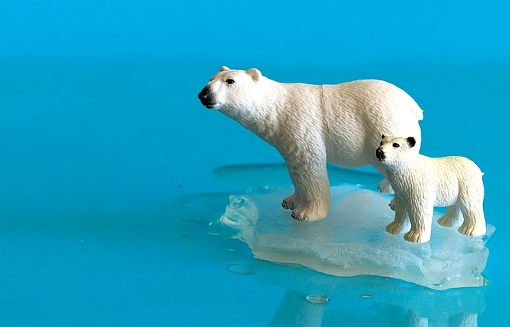
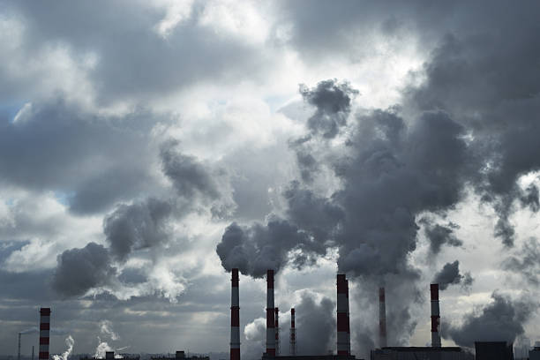
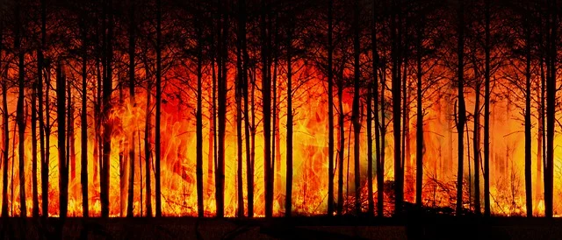
Global Warming - Crisis and response
Root causes of climate change
Too much carbon is emitted by human activities, exacerbating global warming.
Increased extreme weather events
Hurricanes, floods and other disasters are more frequent due to climate warming
Ecosystem imbalance
Climate warming causes damage and threats to ecosystems

Slide 5
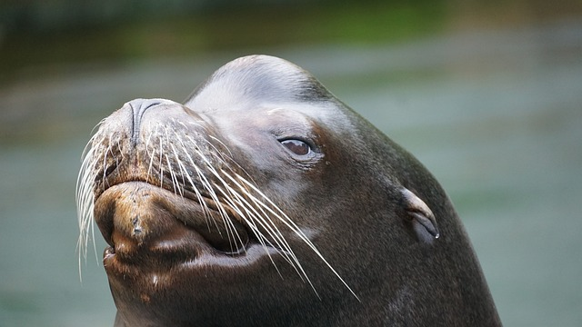
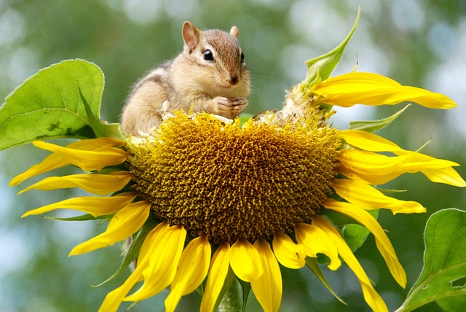



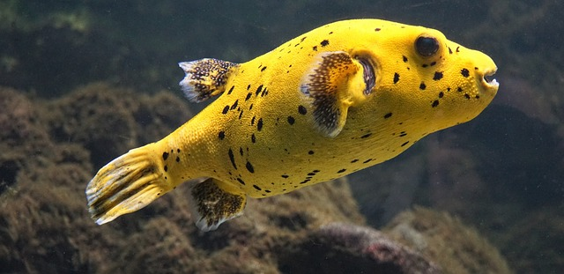
Biodiversity loss
The importance of biodiversity
01
02
03
ecosystem stability
resource utilization
Medical value
The importance of biodiversity to ecosystems and its impact on humans..
Biodiversity plays a key role in maintaining ecological balance.
Biodiversity provides a variety of resources and ecological services.
The contribution of plants and animals in biodiversity to medicines and therapeutics.

Slide 6

land deterioration
A farmer tries his hand at a drought-affected corn field in northern Ghana
Cultivated land desertification
01
Land degradation reduces the yield of farmland and threatens food supplies.
02
land desertification
Desertification has a serious impact on agricultural production.
land pollution
03
Soil pollution has a negative impact on crop growth and human health.

Slide 7
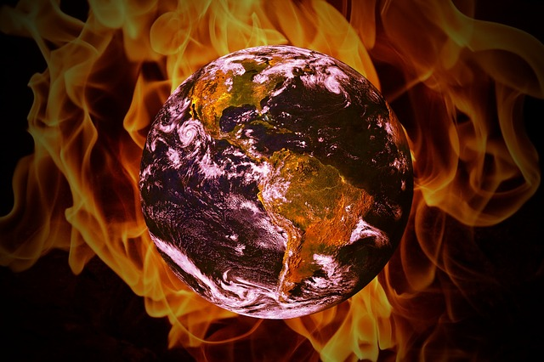
The burning earth
The problem of environmental protection cannot be ignored
air pollution
Emissions from factories and vehicles have a serious impact on air quality.
water pollution
Industrial wastewater and agricultural fertilizer flow into water bodies, threatening water resources security.
land pollution
Industrial waste and pesticide residues cause soil quality to deteriorate

Slide 8
02.Environmental perspective
Policy on environmental issues

Slide 9
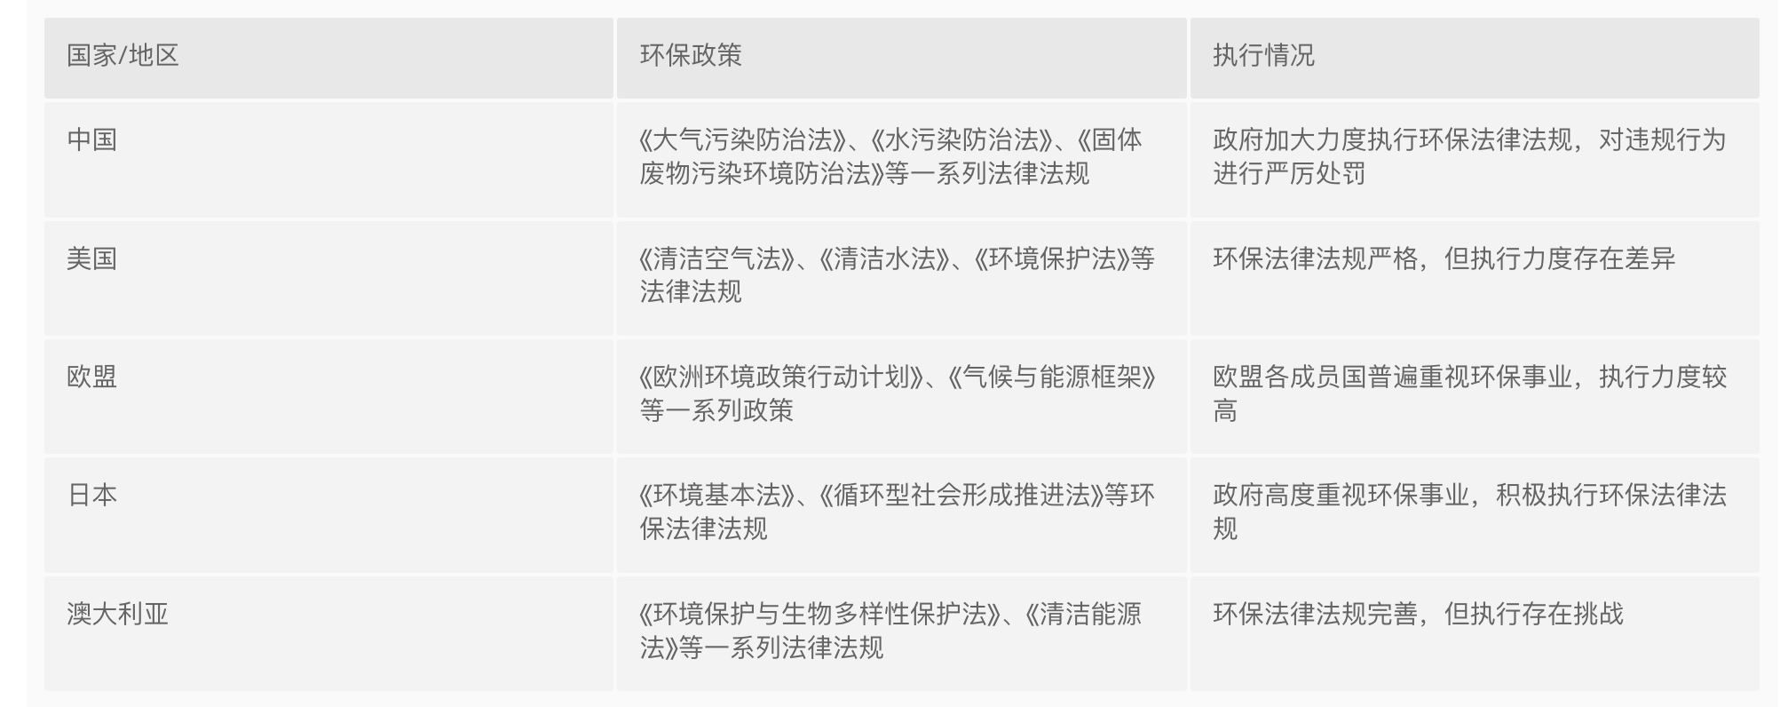
The government attaches great importance to environmental protection

Slide 10
Respect nature for harmonious coexistence
Establish a new ecological concept
Respect for the rights of nature
Eco-community
Sustainable development
Re-evaluating the value and status of nature
Realizing harmonious development between humans and nature.
Meeting human needs while preserving natural resources.

Slide 11
03. Environmental-friendly drift bottles
Socializing and promoting environmental conservation concepts

Slide 12

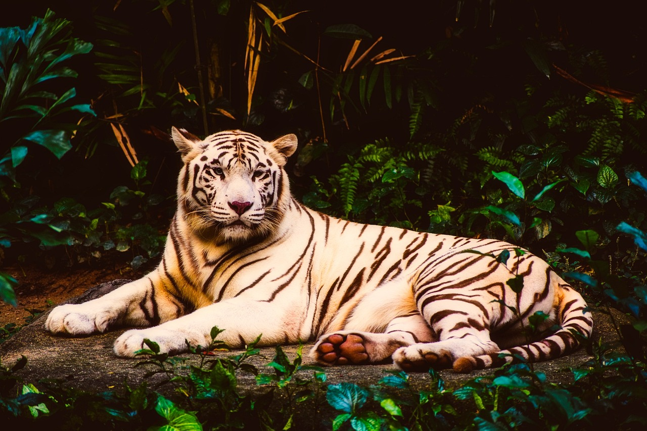

Concern for the fate of the Earth
Drift bottle gameplay
#Tag
Rare creature NFTs
Idea collection
By releasing drift bottle content tagged with labels such as environmental protection, wind power, and new energy, users can earn a certain amount of environmental fund rewards based on the weather in their location.
By releasing drift bottles, there's a chance to draw world-class rare creature NFTs, including both rare and common NFTs.
Public solicitation of environmental conservation ideas, offering substantial rewards in environmental funds and the opportunity for official public investment and promotion.

Slide 13



Environmental conservation small goals
Drift bottle gameplay
Weekly small goals
Praise the battle
Classroom incentive program
If you release more than 4 drift bottles within a week, you can receive a fund reward.
You can draw fund rewards based on the number of likes your posts receive.
Completing paid content publication and passing review within the task period can earn you a substantial amount of environmental fund rewards.

Slide 14




Considering environmental conservation from multiple perspectives
Promoting environmental protection from multiple perspectives
Environmental activities
AI + Promotion
Organizing public environmental conservation activities.
Promote environmental conservation concepts drift bottles.
Policy Sweep-through
Promise
Users can scan the QR code to learn about environmental issues.
Make a donation to the organization.

Slide 15
04.Environmental fund
The role of environmental funds in environmental conservation

Slide 16
What is environmental fund?
The role of environmental funds.
This innovative approach not only encourages people to actively participate in environmental protection activities, but also provides them with more opportunities and rewards.
Redeemable
Environmental identity
Exchange for various environmentally friendly products, such as renewable energy products, eco-friendly household items, as well as unique environmental certificates.
Encourage more people to actively participate in environmental conservation efforts, and collectively contribute to protecting the Earth's environment.

Slide 17


Environmental conservation training camp
Environmental conservation certificate
Environmental talent cultivation

Slide 18
The value brought to the APTOS ecosystem
Thank you, APTOS platform, for the joint development.
Expand the ecosystem
Gateway portal
EFFB will bring users of different types into the Aptos ecosystem, expanding and enriching the Aptos community.
Social and transparent methods will showcase the advantages of APTOS to new user groups, serving as a gateway portal for mainstream consumers to experience the benefits of Aptos firsthand.
Support for new features
Incentivized advertising
EFFB will focus on introducing new features, showcasing the versatility of Aptos, and demonstrating its ability to support next-generation applications.
By displaying environmental advertisements and incentivizing users to watch ads to earn funds, we aim to achieve a revenue growth flywheel for both users and the environment.

Slide 19



New features
KeyLess
Pay for another
randomness

Slide 20
Tokenomics
Token：“$EFFB”
Total: 100000000000000
25000000000000 %25 Users
25000000000000 %25 Environmental protection organization
20000000000000 %20 Burn
10000000000000 %10 Marketing airdrop
16000000000000 %16 Team development
4000000000000 %4 Marketing fund

Slide 21
05.Future prospect
Platform and community for global environmental conservation

Slide 22
Green Action Guide
Methods for implementing environmental conservation principles
Encourage recycling
Sort waste and participate in recycling projects
Save energy
Use low-energy consumption devices and natural light.
Reduce plastic usage
Use biodegradable alternatives

Slide 23
World environmental platform and community
Building a global environmental platform and community
Public interest
A new economic model
Environmental benefit
The ultimate goal is to establish a decentralized, self-sustaining economy that drives technological innovation and charitable donations.
This model encourages individual participation, creating a balanced ecosystem.
nvironmental organizations will receive token payments equivalent to the scale of token payments from individual participants.

Slide 24
Promotion of environmental conservation principles
User promotion
Promotional education
Collaborative interaction
Promote environmental knowledge through social media platforms and environmental drift bottles, among other methods.
Collaborate with various environmental organizations, schools, businesses, and governments to jointly promote environmental conservation initiatives and policies
Cultivating habits
Organize activities
Continuously create novel, engaging, and educational environmental content to cultivate environmental awareness and habits from a young age
Organize environmental activities to encourage societal participation.

Slide 25

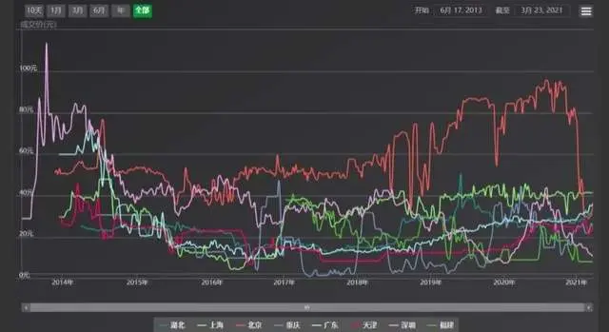
Carbon trading market

Slide 26
Our future and vision
Promote sustainable development
1
Protect ecosystems
Promote harmonious development among the economy, society, and environment.
Maintain biodiversity and ecological balance
2
Raise public environmental awareness
3
Environmental policies
Enhance public awareness and concern about environmental issues
4
Develop scientific and rational proposals for environmental protection.
5
Shape societal values
Address environmental challenges
Foster respect and responsibility for the environment in people.
6
Promote international cooperation to address issues such as climate change.

Slide 27
Thank You

